Slide 1
Civil Rights
1940s – 1970s

Slide 2
Ending of the White Primary in Georgia in 1945
Primaries in Georgia were Democratic primaries because Georgia was a one-party state.
African Americans were not allowed to join the democratic party which resulted them in not being allowed to vote or run for office. (no white would vote a black into office)
A black resident of Columbus Georgia, Primus King, registered to vote and then tried to vote at the Muscogee County Court House, in Georgia but was thrown out.
Primus was represented by NAACP and other lawyers.
In King v. Chapman et. al. , the Supreme Court ruled in favor of King, ending the white primary.
King showing his check from the state of Georgia after winning his court case.

Slide 3
Georgia Leaders begin to emerge in the 1940s
Rev. Benjamin Mays
Born to former slaves who eventually earned his PhD in Chicago
Traveled to India and met Mahatma Gandhi to learn passive resistance strategies (non-violent)
Began President of Morehouse College here in Atlanta in 1940
MLK Jr. arrived at Morehouse in 1944 and became friends with Mays
Mays became MLK’s mentor

Slide 4
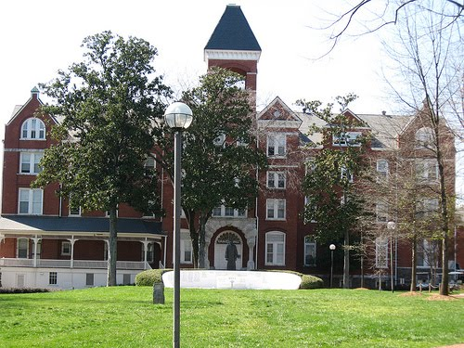
Morehouse
Morehouse College in Atlanta – The “cradle” of the Civil Rights Movement
Morehouse produce influential civil rights leaders for decades such as MLK Jr.

Slide 5
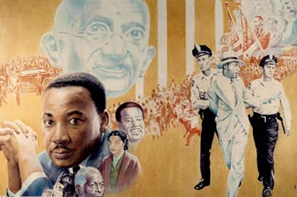
MLK Jr. and his role in Ga.
Most well known Georgian Civil Rights Leader. Also known as the “father” of the modern civil rights movement
When to Morehouse college in Atlanta.
Earned the Nobel Peace Prize (only 1 of 2 Georgians)
Created the SCLC (Southern Christian Leadership Conference) group of Black minsters who fight for civil rights.
Led protest in Albany Georgia as part of the Albany Movement
Taught Non-Violence strategies learned from Gandhi in India.

Slide 6
John Lewis and his role in the Civil Rights Movement
Became a integral part of Georgia’s history through his leadership in the Civil Rights Movement.
Active in the 1960’s sit-ins to protest Jim Crow laws.
Participated in the Freedom Rides of the early 1960’s.
Became the chair of the new organization, the Student Nonviolent Coordinating Committee.
Was a keynote speaker at the 1963 March on Washington for Jobs and Freedom.
In 1965, Lewis led over 600 marchers across the Edmund Pettus Bridge in Selma, Alabama only to be beaten by Alabama state troopers.
Elected to the Atlanta City Council in 1981.
In November 1986, Lewis was elected to the United States Congress from the Fifth Congressional District where he continues to serve today.

Slide 7
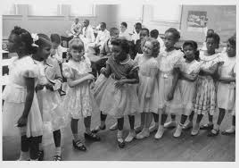
Brown Vs. Bd. Of Education – 1950’s
1954 Court Case in Topeka Kansas
Oliver Brown sued the district to allow his daughter to go to the all white school 4 blocks from their neighborhood.
The U.S. Supreme Court ruled in favor of Brown and stated “separate but equal” was unconstitutional.
This will overturn Plessy Vs. Ferguson as far as schools go.
Other public facilities will remain separate.
However many southern states will ignore the ruling, claiming “nullification”
Video: https://www.youtube.com/watch?v=TTGHLdr-iak

Slide 8
Impact of Brown Vs. Bd. Of Ed. On Georgia
The Georgia Assembly was opposed to the ruling.
They declared the decision null and void (what is good for Kansas does not mean it is good for Georgia)
After the decision, the Assembly gave power to the Governor to decide what to do.
Governor of Georgia, Marvin Griffen, urged massive resistance from Georgians and other states in the deep south.
He threaten to close any public school rather than comply.

Slide 9
1956 Georgia Flag
In early 1955, an Atlanta attorney proposed a new flag design, one that would incorporate the Confederate Battle Flag.
At the 1956 session of the General Assembly, State Senators Jefferson Lee Davis and Willis Harden introduced Senate Bill No. 98 to change the state flag design again
Many think the assembly changed the flag for two reasons:
Protest Civil Rights Legislation (Brown vs. Bd. Of Ed.)
Mark the upcoming centennial celebration of the Civil War.
House Bill No. 98 was signed into law by Governor Marvin Griffin on February 13, 1956, effective July 1, 1956.

Slide 10
Current Georgia Flag
As the civil rights movement continued to grow and change America, many Georgians thought the state flag should be changed.
Zell Miller who was governor of Georgia during the 1996 Olympics tried to get the flag changed before the Olympics started for fear it would show Georgia as still living in the past.
However the flag would not be changed unit 2001 when then governor Roy Barnes changed the flag without the assembly approval. This upset many people in Georgia so a new design was drawn up.
In 2003, the people of Georgia were allowed to vote on a new flag that is the flag we still use today.

Slide 11
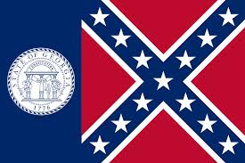
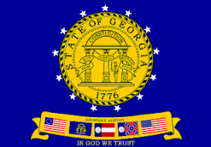
Compare Ga. Flags
Flag from 1920 - 1956
1956 Flag
2001 Flag
Current Flag

Slide 12
Civil Rights Events and their impact on Georgia
Sibley Commission –
Most of the state’s school systems refused to desegregate
However in 1960, the Georgia General Assembly recognized schools had to change, the question was how.
To address this issue, the Governor put together a fourteen-member commission to study the problem.
They held hearings all over the state asking parents, students, and teachers how they felt about desegregation.
They learned that 60% of the people did not want to desegregate. Those that did favor desegregation were found in the more urban areas.
The commission recommended to the Governor that desegregation be left up to the local school district.
Fulton County was the first district to desegregate in Georgia

Slide 13
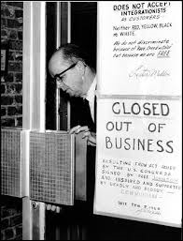
Lester Maddox – Governor of Georgia in the 1960’s
Born in Atlanta and was a high school drop out.
Opened The Pickrick restaurant near Georgia Tech and was very successful.
He refused to serve blacks. He was known for running them off with an axe handle.
After the Civil Rights act of 1964, he decided to close the restaurant rather than serve blacks.
Watch video: https://www.youtube.com/watch?v=7m3JCPrQ3zs

Slide 14
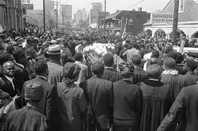
Lester Maddox continued
After he became governor in 1967, he surprised most people.
He appointed more blacks to government positions than all other governors before him.
Appointed 1st black state patrol officer
When MLK died, Maddox refused to lower state flags to half-mast for fear of riots

Slide 15
Events Continued
Albany Movement:
In 1961, Albany Georgia became a center of civil rights activity.
40% of their population was black and still lived in a segregated community.
SNCC organized a community civil rights protest.
They protested public transportation, public restaurants as well as schools.
The protest lasted for over a year but is considered to be a failure because the civil rights laws were not changed.
MLK learned many lessons from Albany such as do not try to protest all parts of society at the same time. Focus on one part and win that right then focus on another.

Slide 16
Video on Albany Movement
http://stinsonvirtualclassroom.wikispaces.com/Unit+09+-+The+Modern+Civil+Rights+Movement
https://www.youtube.com/watch?v=F7dGWAY2AcM
https://www.youtube.com/watch?v=rBrZ4utBse8

Slide 17
March on Washington
President JFK sent the strongest civil rights bill in history to Congress on June 19, 1963.
This called for an end to discrimination in all aspects of life.
However congress was taking its time passing the bill so the leaders of the SCLC organized a massive March on Washington in August 1963 to show citizen support for Civil Rights.
250,000 people representing all races, beliefs, and nationalities gathered before the Washington Monument to demonstrate support for the civil rights bill.
Protestors were demands equality for Jobs and Freedom.
MLK gives his I Have A Dream Speech at the march.
This march will lead to the signing of the 1964 Civil Rights bill.

Slide 18
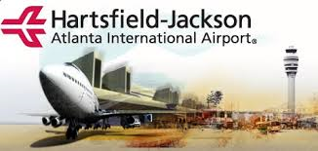
Maynard Jackson- Mayor of Atlanta 1970’s
Elected as the 1st black mayor of Atlanta (1st mayor of a major southern city) in 1973.
His crowning achievement was building the massive new terminal at Hartsfield Atlanta International Airport
In 2003 the airport's name was changed to Hartsfield-Jackson Atlanta International Airport in Jackson's
He was also involved in the bid to bring the 1996 Olympic Games to Atlanta, he represented the city at the 1992 games in Barcelona, Spain.

Slide 19
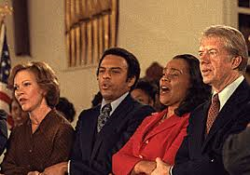
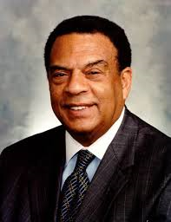
Andrew Young 1960 – current civil rights leader
Assistant to MLK, during his time at the SCLC, he successfully organized demonstrations and voter registration campaigns throughout the South.
He was elected as Georgia’s first African American or Black Congressman since Reconstruction. In 1977,
Participated in bringing the Olympics to Atlanta.
Followed Maynard Jackson as 2nd black Mayor of Atlanta.
Known as the 1st black appointed to be U.S. Ambassador by Pres. Jimmy Carter to the United Nations in New York.

Slide 20
Civil Rights Acts of 1964 and 65
After the March on Washington in 1963, Pres. JFK sent another bill to congress asking them to help with the moral crisis facing the country.
Kennedy will be assassinated on Nov. 23, 1963 before the bill is signed.
Vice President Lyndon B. Johnson becomes President.
One of the first things he will do is sign the bill into law in 1964. This will become known as the Civil Rights Act of 1964.
This act will prohibit discrimination in all aspects of life: public places, employment, and schools. (Except churches)
In 1965, he signed a second act which is known as the Civil Rights act of 1965.
This will end voting discrimination of any kind.

